Slide 1


Titanic Meets the Iceberg:
Closing Wikinews
Victoria Doronina

Slide 2
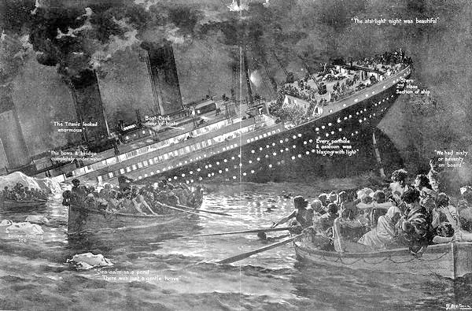
The original Titanic - an unsinkable ship
Wikipedia:
The largest ocean liner in service at the time, RMS Titanic sank in the North Atlantic Ocean on 15 April 1912
Willy Stöwer : “Sinking of the Titanic” - public domain via Wikimedia Commons

Slide 3

What are “the Sister Projects?”
Sister Projects - MediaWiki-based projects supported by the WMF
(NOT wikimedia projects in different languages, not specifically English or French Wikinews)
Opening and closing of these projects is the Board’s mandate
But what do we do with the Sister projects that failed to live to the expectations?

Slide 4
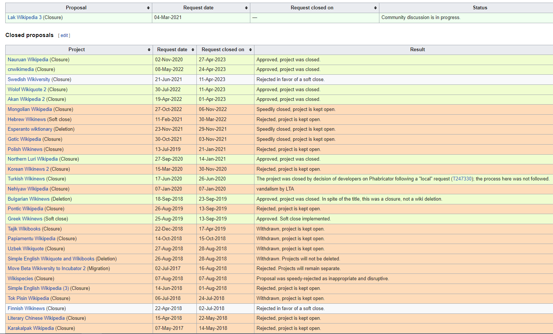
Proposals for closure – mainly Wikipedias and Wikinews by Language Committee
Wikispecies –
speedy rejected
as out of scope

Slide 5
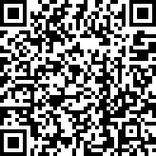
Sister Project Taskforce (SPTF)
Sister Projects Taskforce was formed in January 2023 under now defunct Community Affairs Committee (CAC) of the Board of Trustees: 6 trustees, 5 wikimedians selected via an open call on Meta and wikimedia-l.
Workshop on Sister Projects during Wikimania 2023.
and during Wikiconference North America 2023.
Q: What are the candidates for opening and closing?
Learn more here

Slide 6

A policy for opening and closing the Sister Projects
Developed the policy for the evaluation of the Sister Project Lifecycle, which was approved in the first draft by the Community Affairs Committee in 2024.
Run a public consultation about the policy on Meta & global calls in May - June 2024
The revised policy was approved by the CAC in July.
SPTF was given a mandate by CAC to test the policy by evaluating one project for possible opening as a Sister Project and one for closing.

Slide 7
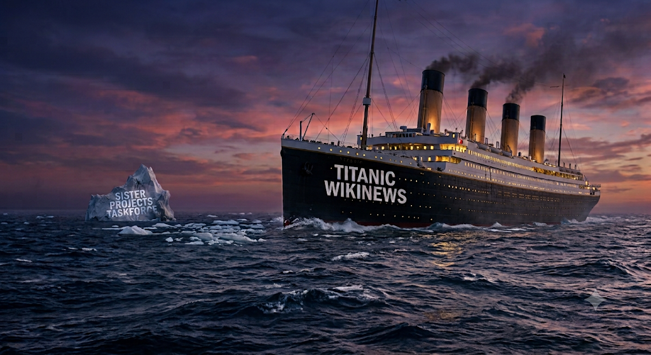
Wikinews: a case for closure
Nano Banana Pro

Slide 8

Wikinews: the problems are multi-level
Most of the content is non-verifiable and often is not NPOV.
2) No synergy with other Wikimedia projects: Other Wikimedia projects are not relying significantly on Wikinews.
3) Limited use to people: Search engine statistics shows that users are not searching for and finding relevant information on Wikinews. Over 70% of read traffic to Wikinews comes from search engine crawlers, not people. Of the top search queries to Google that show Wikinews results in a given month, less than 5% are news related
4) Poor community health of some editions: On Russian Wikinews the vast majority of edits over a year are made by bots, and on Chinese Wikinews 3 human editors generate >70% of all edits.

Slide 9

Wikinews: the problems are multi-level
4) Limited use to people: Search engine statistics shows that users are not searching for and finding relevant information on Wikinews. Over 70% of read traffic to Wikinews comes from search engine crawlers, not people. Of the top search queries to Google that show Wikinews results in a given month, less than 5% are news related
Let's compare similar articles, such as about a national election 2025 in Poland:
Wikipedia: 117,000 page views in the last month
Wikinews: 175 page views in the last month
Or the release of the Nintendo Switch 2:
Wikipedia: 4,200 page views in the last month
Wikinews: 2 page views in the last month
Or the election of the new Pope in May:
Wikipedia: 44,350 page views over a month
Wikinews: 309 page views over a month WhatamIdoing (talk) 05:19, 3 July 2025 (UTC)
Talk:Public consultation about Wikinews - Meta (https://w.wiki/Edzu)

Slide 10
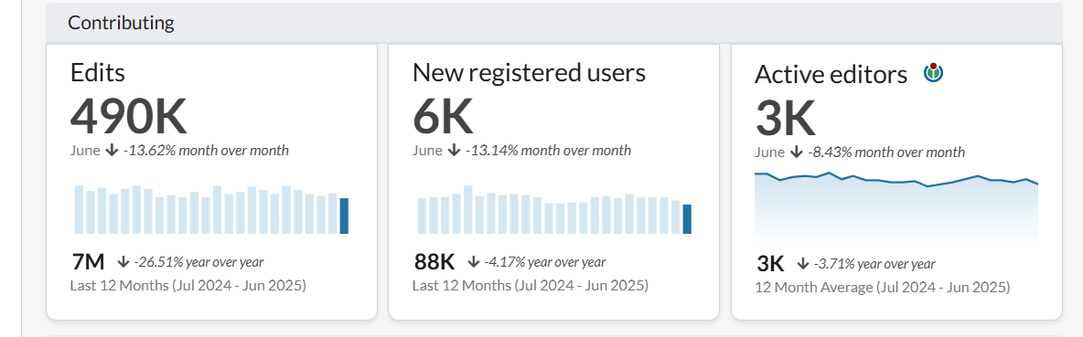
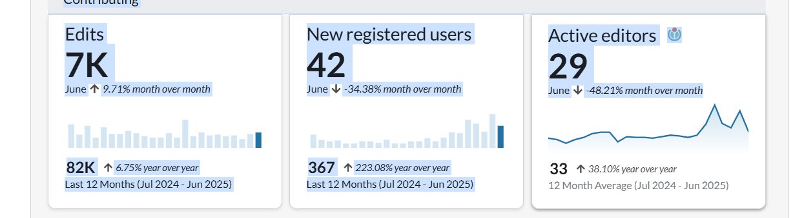
Wikinews: the problems are multi-level
5) Poor community health of some editions: on Russian Wikinews the vast majority of edits over a year are made by bots, and on Chinese Wikinews 3 human editors generate >70% of all edits.
Russian Wikipedia, 2 055 015 articles
Russian Wikinews, 1 496 000 articles

Slide 11

SPTF recommendations
Made two recommendations to the Community Affairs Committee of the Board of Trustees: not to approve Wikispore as a new Sister Project and close Wikinews
Community consultations about the Wikispore and Wikinews: started in June, extended until 15th August
Discussed at Wikimania 2025 (10 people attended)
In December 2025 the Board of Trustees approved Wikinews closure
In January 2026 the SPTF was officially disbanded
Wikinews were made read-only in April 2026

Slide 12
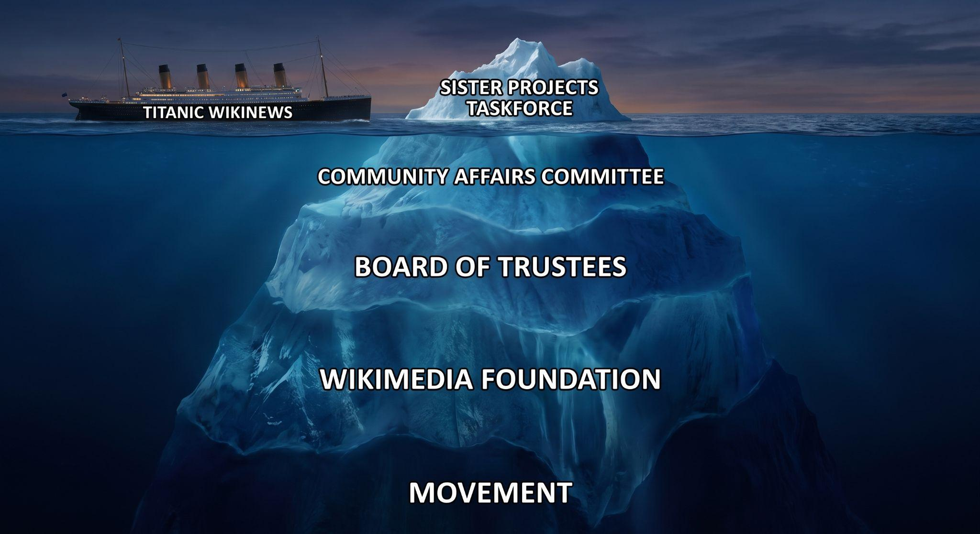
There’s plenty of Titanics in the sea
SPTF is no more, but the Procedure for Sister Project Lifecycle remains
Nano Banana Pro

Slide 13
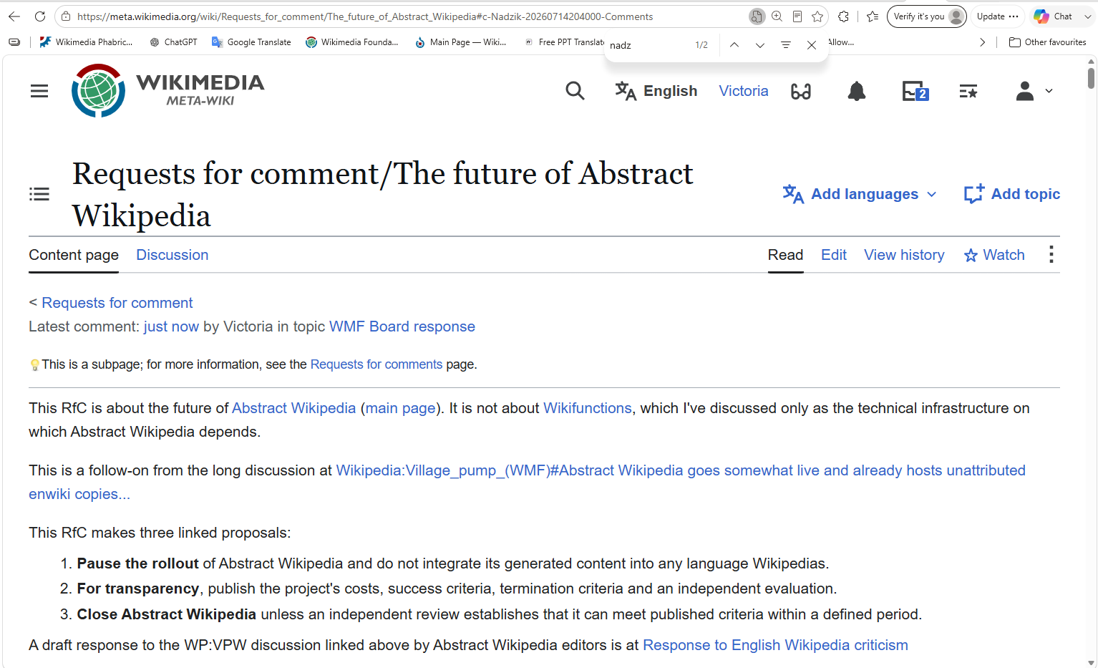
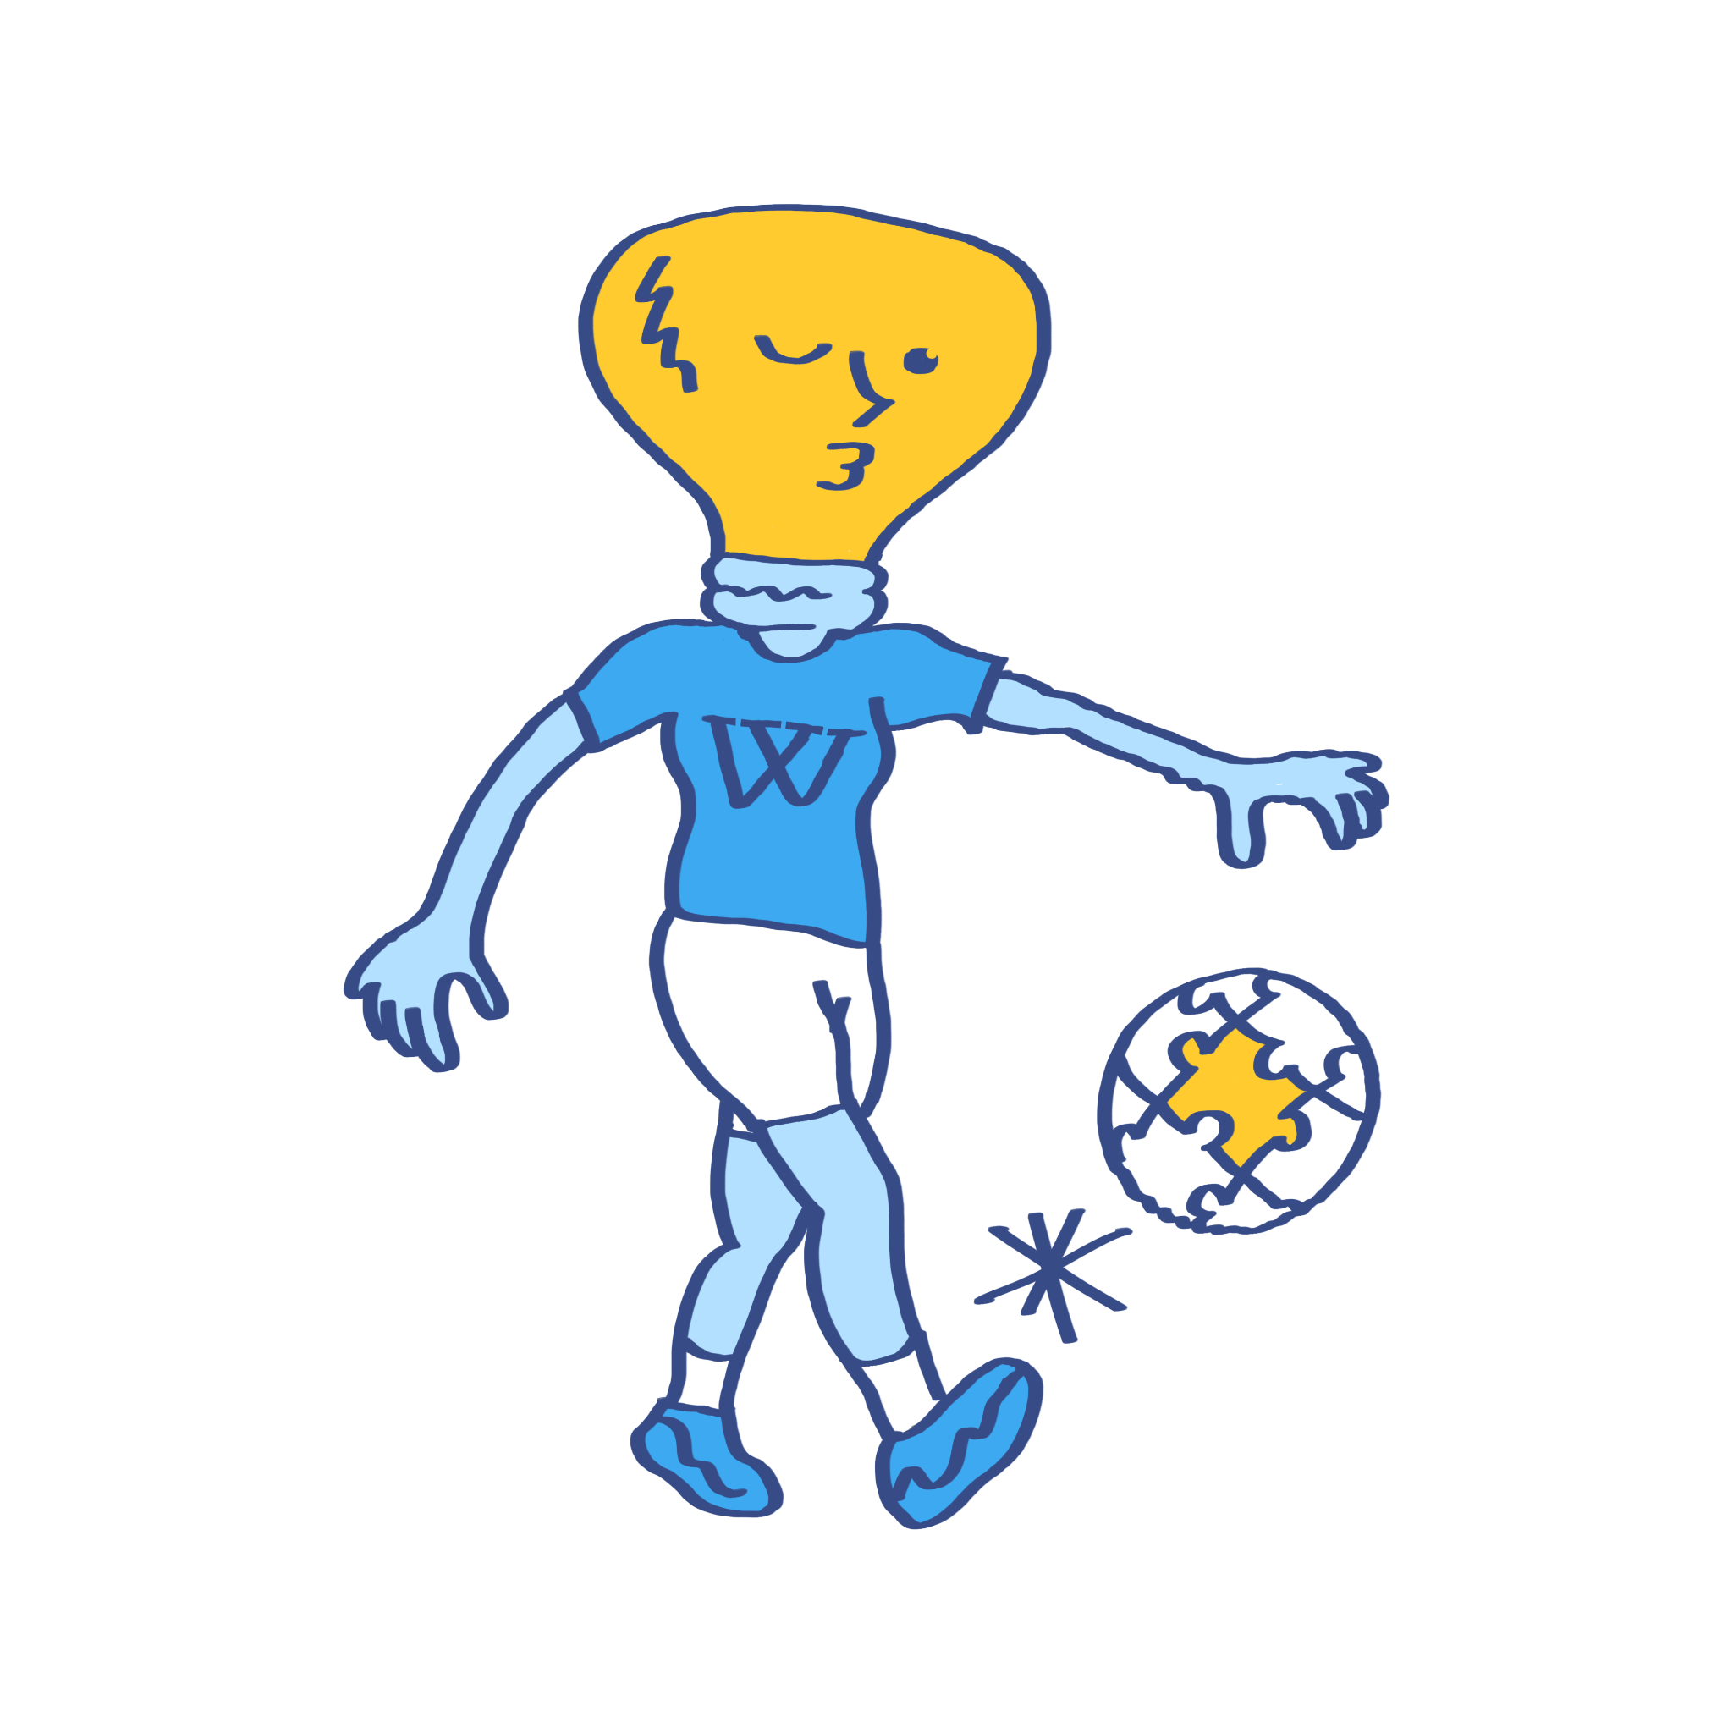
Here we go again

Slide 14

Discussion:
How should movement-wide discussions be organised for difficult
project decisions?
What would make such a process feel legitimate to communities,
the Board and readers?

Slide 15
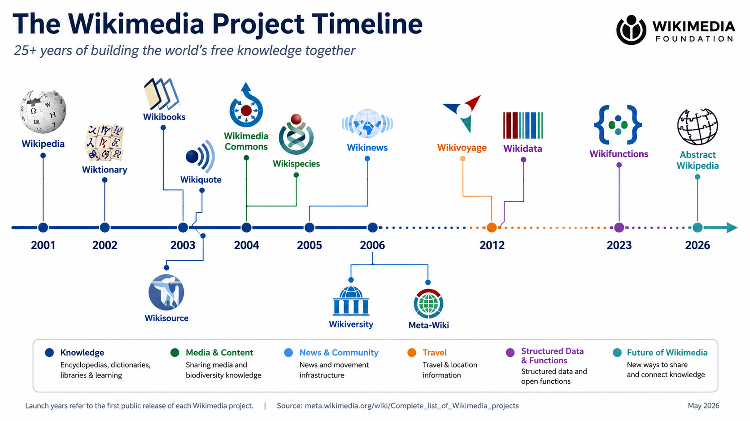

Slide 16

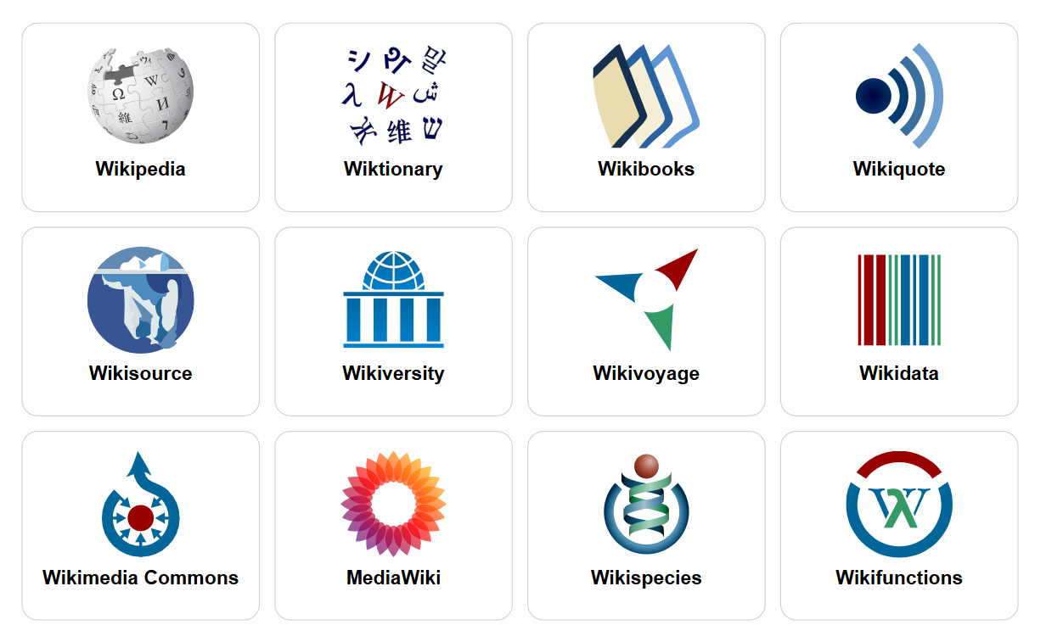
Discussion:
How should movement-wide discussions be organised for difficult project decisions?
What would make such a process feel legitimate to communities, the Board and readers?

