Slide 1
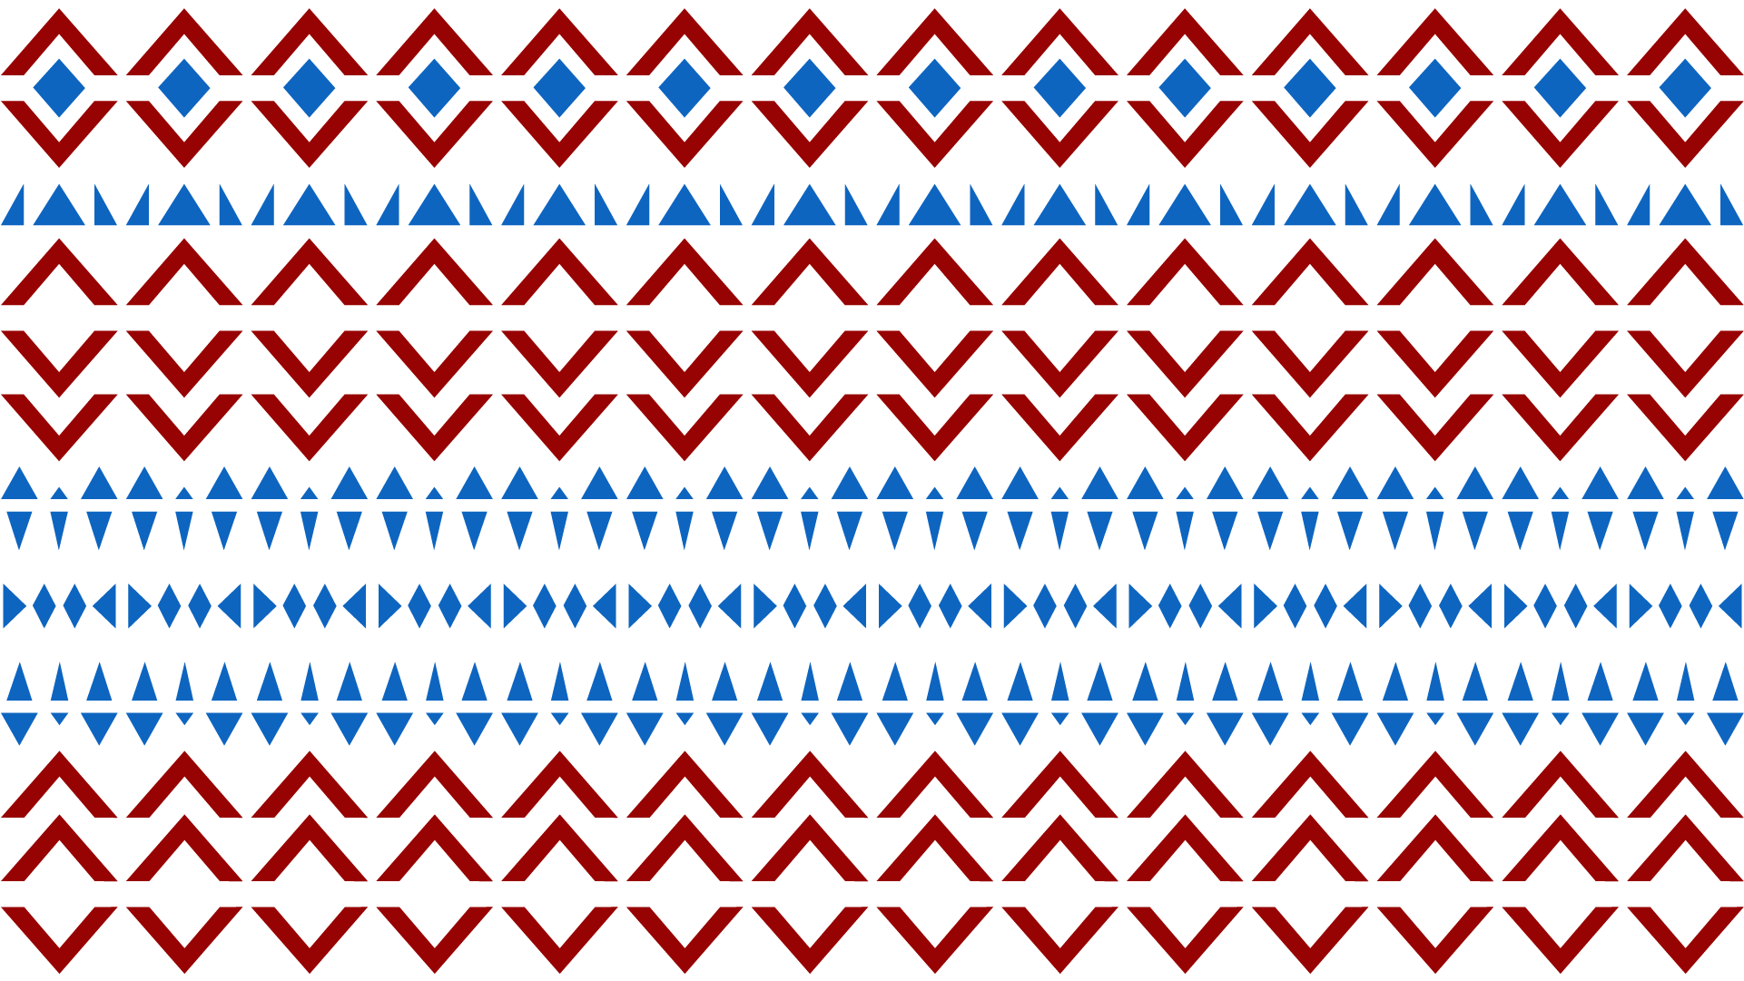

WWikiEducation of people
with Disabilities: Challenges, Features and Prospects
Marysia Lebid (Wikimedia Ukraine)

Slide 2
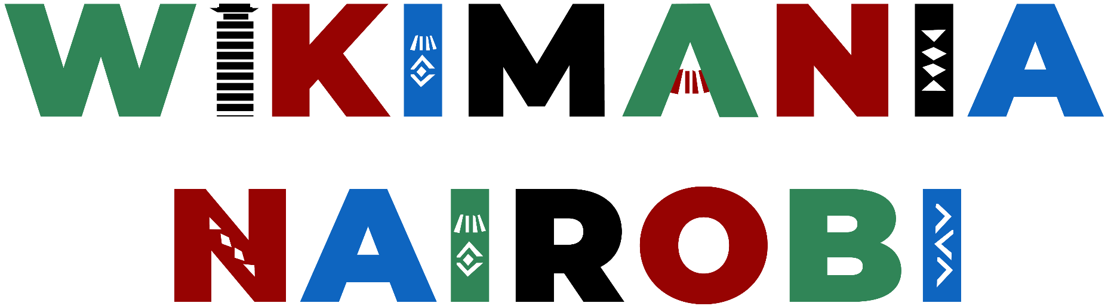
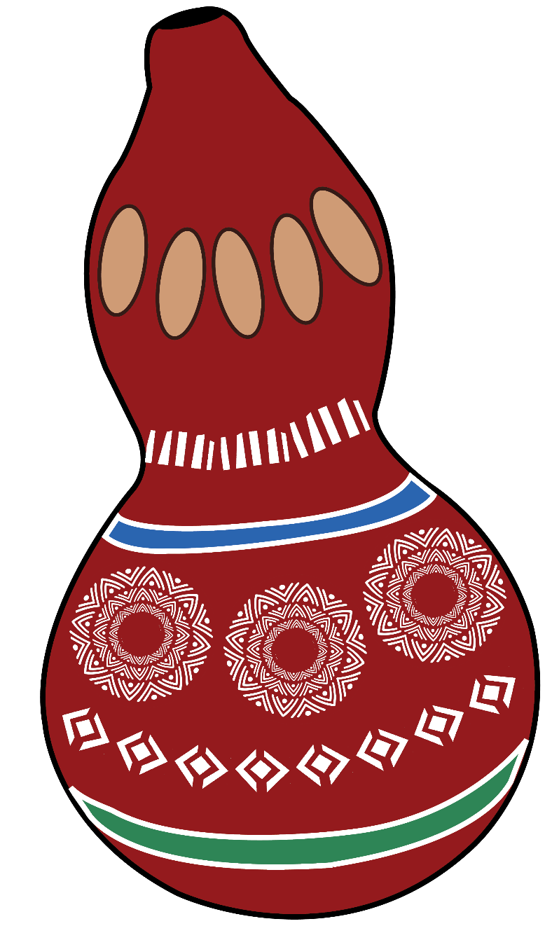
WikiEducation
WikiEducation - is an inclusive approach to learning through participation in Wikipedia and related projects.
How can we make this process accessible and effective for people with disabilities?
Key Challenges
Accessibility barriers: physical, sensory, cognitive
2) Technical difficulties: inaccessible interfaces
3) Lack of specialized resources
4) Stigma and lack of support

Slide 3

Features of WikiEducation for People with Disabilities
1) Inclusive teaching methods
2) Supportive technologies (screen readers, adaptive keyboards)
3) Flexible content formats
4) Mentorship and community support
and other …

Slide 4
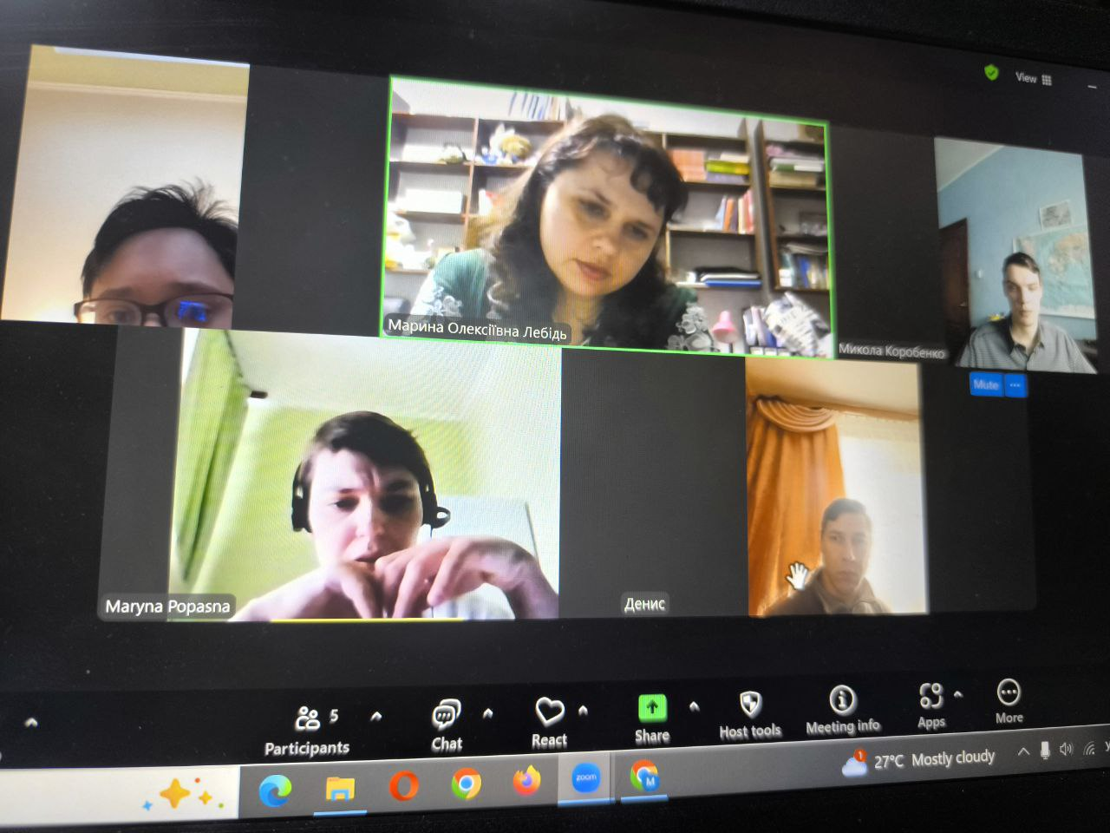

Success Stories:
I am coach Ukrainian speaking club for people with disabilities from different parts of Ukraine: Luhansk, Dnipropetrovsk, Cherkasy and Zhytomyr regions.
Most of our participants rarely go outside due to health challenges such as cerebral palsy, autistic spectrum, Down syndrome and others.

Slide 5
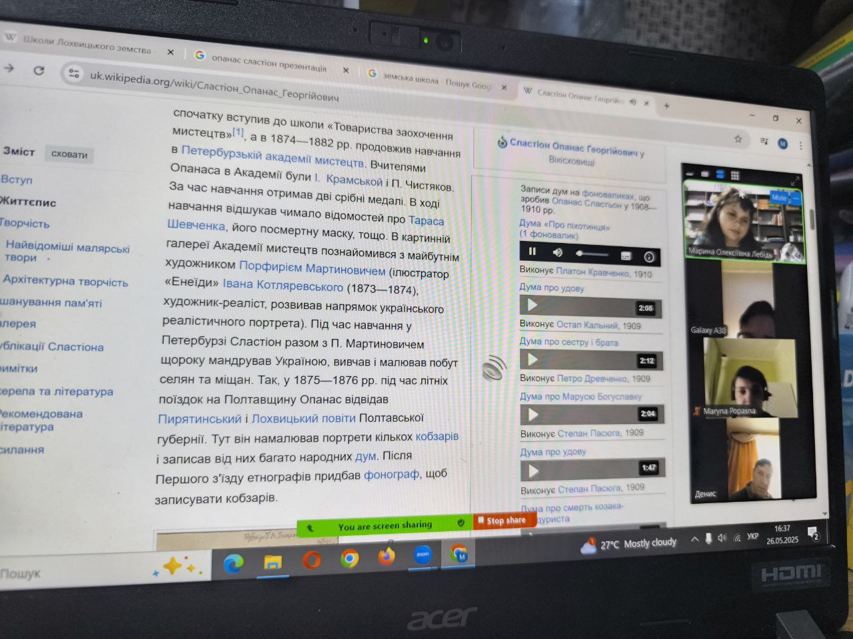
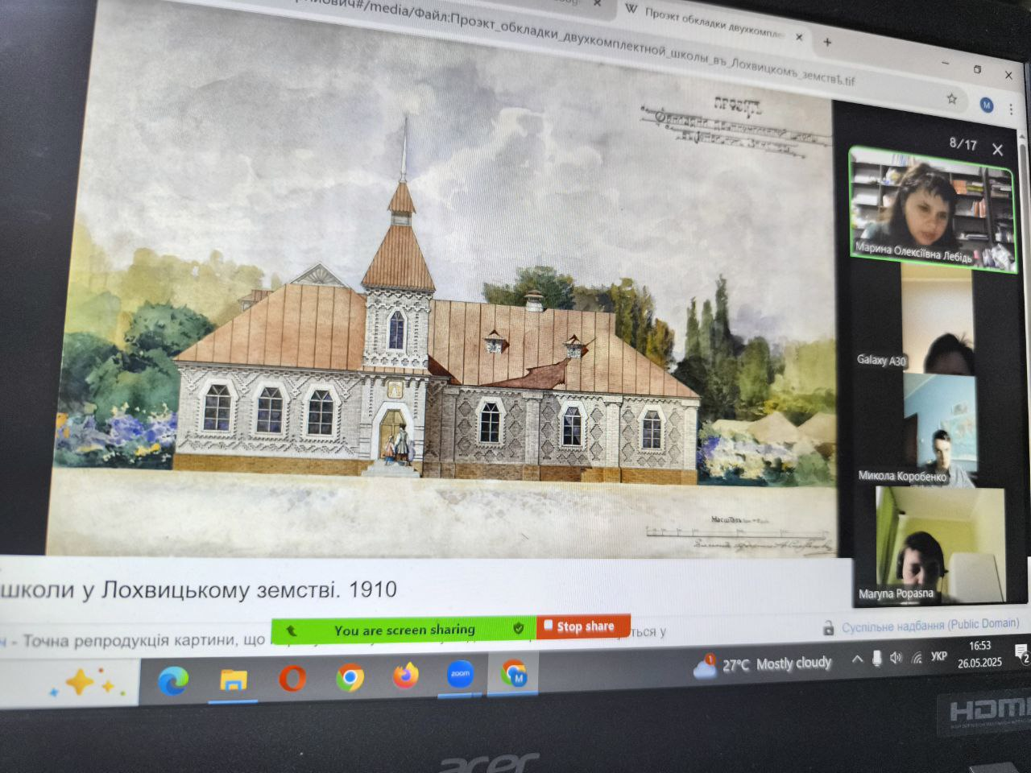
Our club meets twice a week to talk, support each other and learn something new.
We use WikiProjects that greatly help our learning process. Together we read WikiArticles.
view photos and listen to audio files from Wikimedia Commons, choose our favorite Wikiquotes and check information sources.
Notes:
Ask for comments in the chat area so as to manage expectations

Slide 6
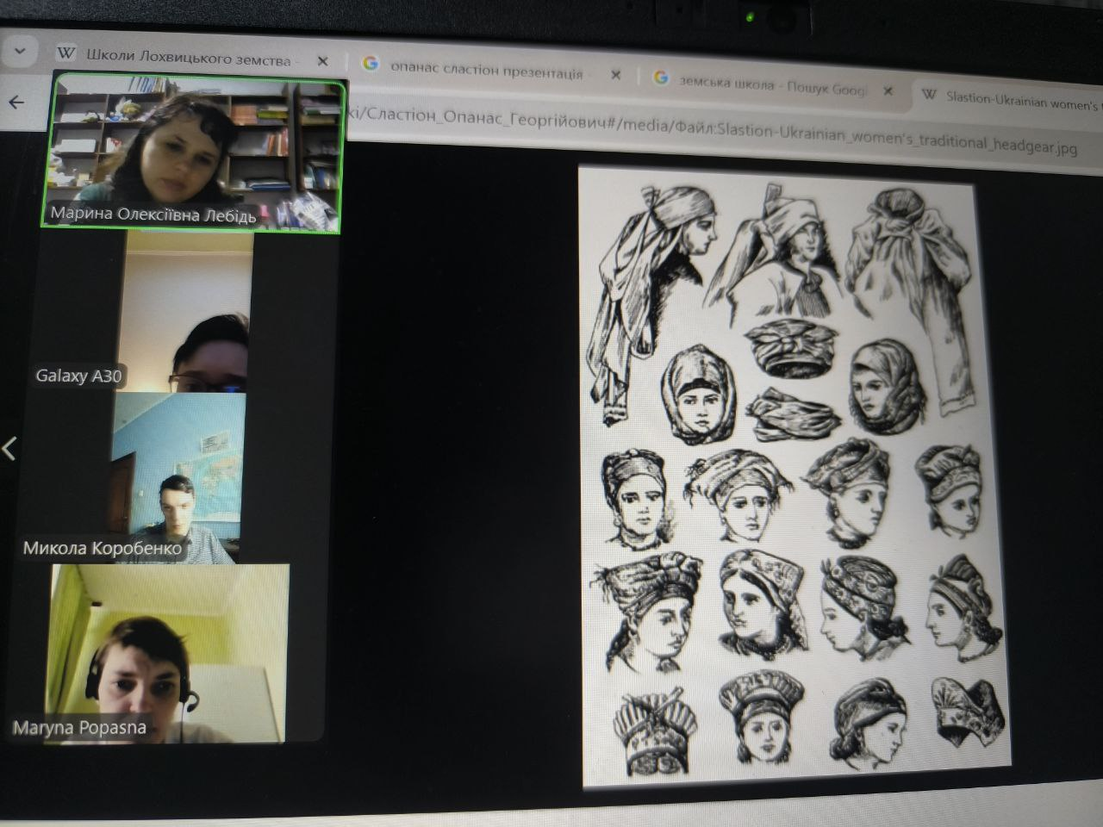
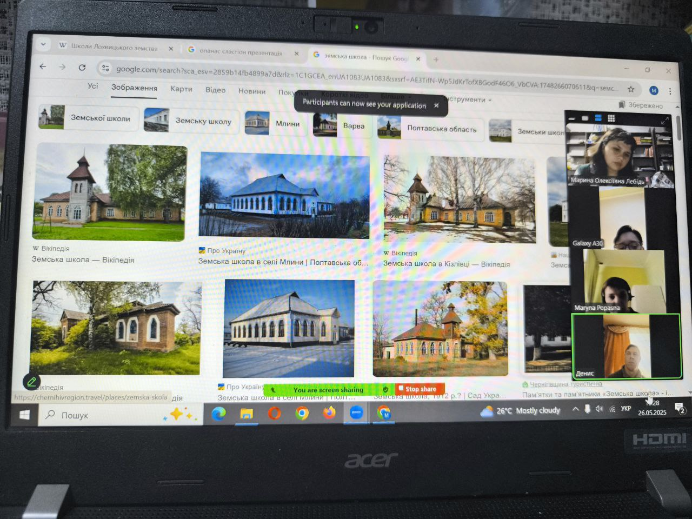
This is an important opportunity for us to be together, grow, and overcome isolation.
WikiEducation for people with disabilities is a path to equal learning opportunities, expression, and empowerment. Joint efforts, innovation, and inclusivity open new horizons!

Slide 7
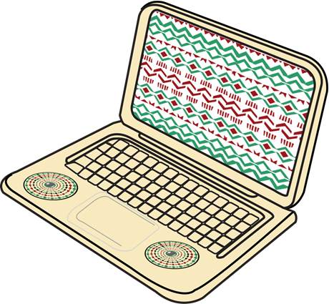
Thank You for your attention!
Wiki nickname: Marysia Lebid
Facebook: https://www.facebook.com/masya.morskaya?locale=uk_UA (Марина Лебідь)
E-mail: marysia_lebid@ukr.net
Phone: +380999124963

