Slide 1
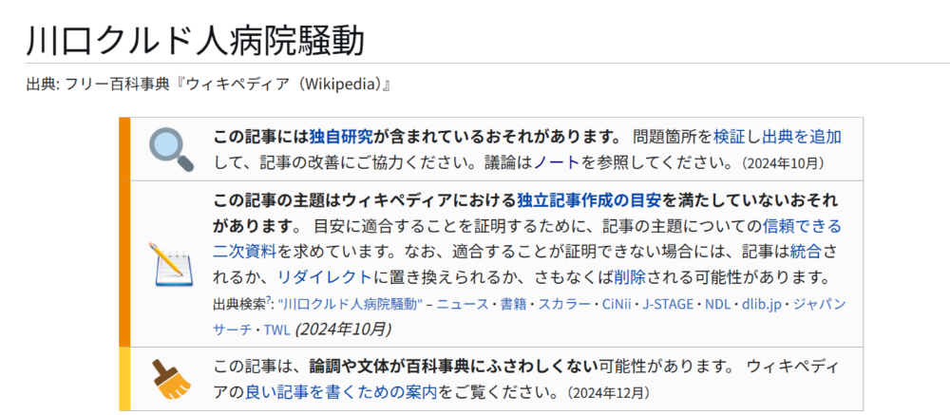
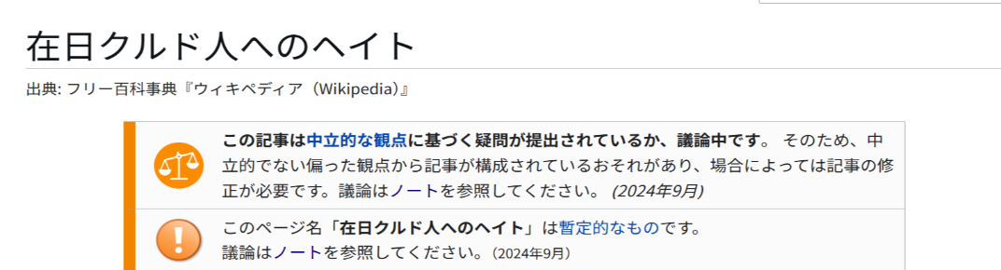
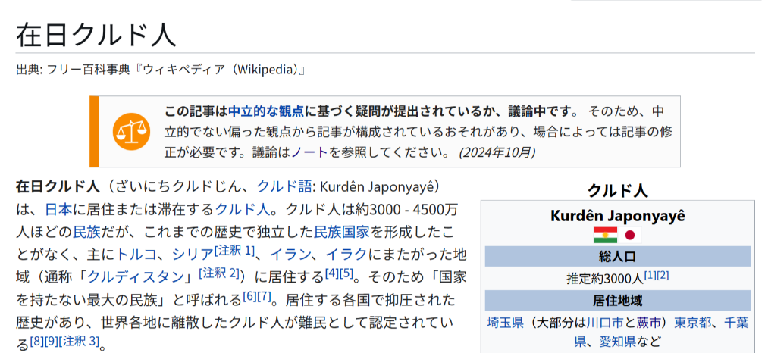
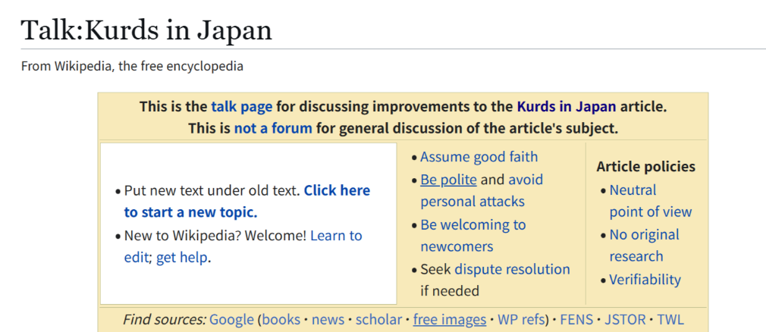
The Problem of Anti-Kurdish Bias in Japanese Wikipedia
KITAMURA Sae (user:saebou)
6 August 2025
12:15–12:40, ELDORET (Clubhouse)
Wikimania Nairobi

Slide 2
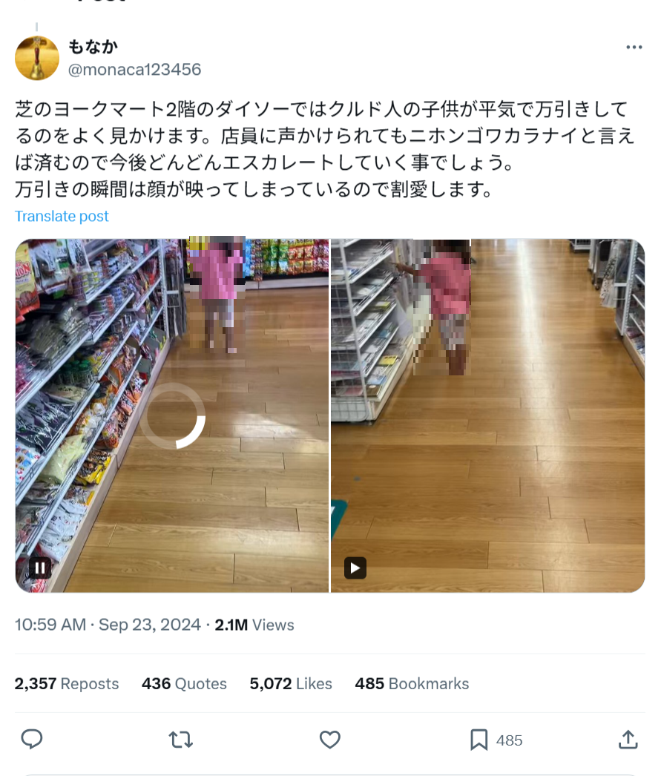
Kurdish People in Japan
Japan has no ethnicity questions on the census
About 2000 – 3000 Kurdish residents live in Japan, mostly in ‘Warabistan’, or the area around Warabi and Kawaguchi.
2023 July Kawaguchi brawl
Hate speech and fake accusations
→Anti-hate speech by-law in Kawasaki
https://archive.md/yWVzn

Slide 3
Kurd-related Articles in Japanese Wikipedia
[[Kurds in Japan]] – Dubious sources, including The Epoch Times, which was ‘deprecated’ in 2019 in English Wikipedia ([[Wikipedia:Reliable sources/Perennial sources]])
[[Hate against Kurds in Japan]]
[[Kawaguchi Kurds hospital brawl]] (previously [[Kawaguchi 100 Kurds hospital brawl]])
[[Kurd car]] (merged)
[[Kawaguchi Kurds problem]] (merged)

Slide 4
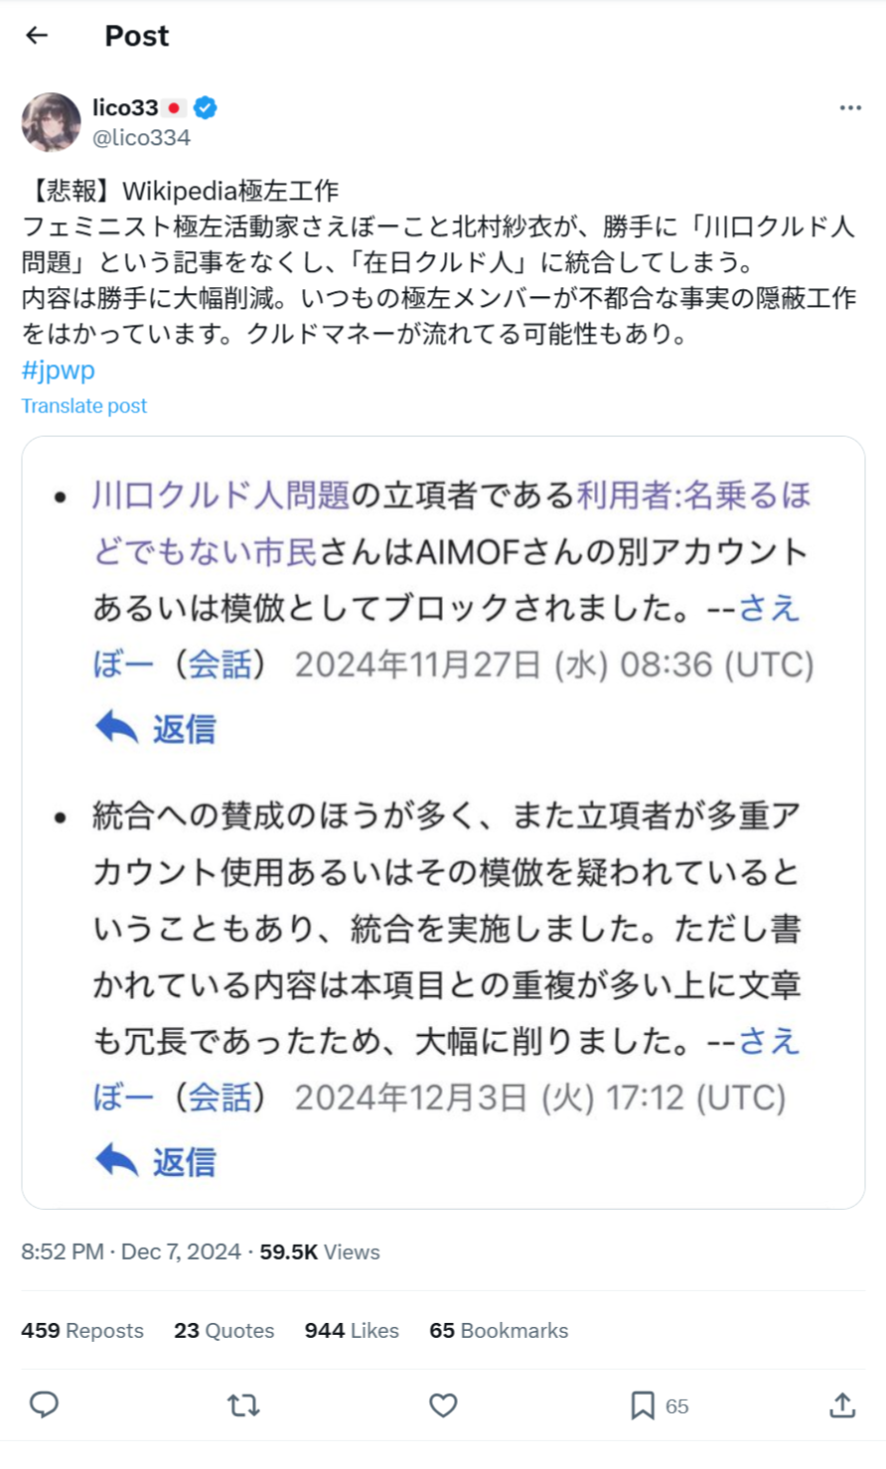
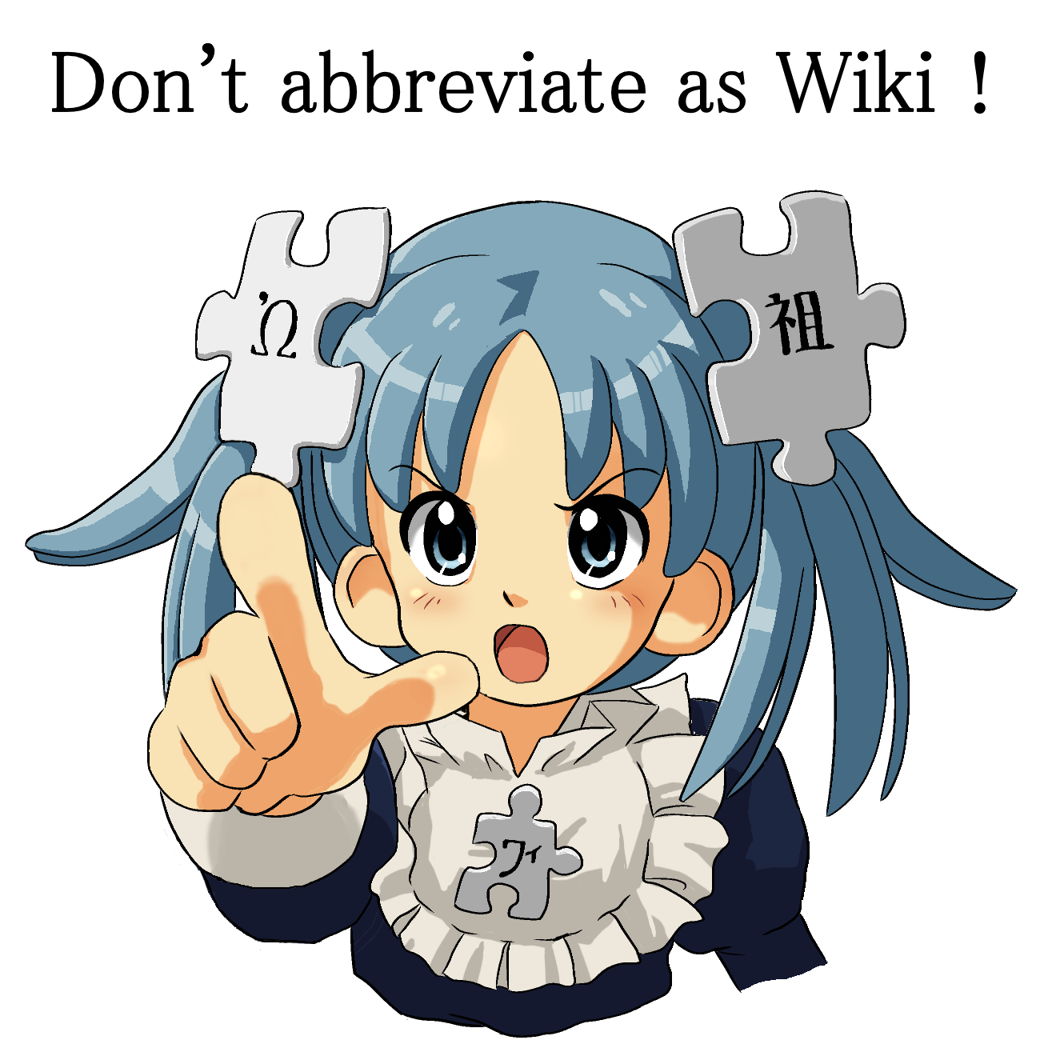
Online Harassment
https://archive.md/9JLrj

Slide 5
What Should We Do?
Proper references (library access, databases, books…)
Better articles about Kurdish people and culture ([[Kurdish literature]] – GA, December 2024)
Recruiting specialists and researchers

